Slide 1
Histogram-Based Solutions to Diverse Database Estimation Problems

Slide 2
Size estimation is important in database field!
DBMSs need them to generate a optimized query plan
Users want them to know if their queries is executed correctly and effectively

Slide 3
…But how to do a size estimation?
Histogram

Slide 4
Some definitions…
Frequency distribution
For given attribute of a relation, it’s a set of pairs indicating, for each value in the attribute’s domain, the number of tuples in the relation where the value appears
Histogram
A histogram of some attribute is an approximation of the frequency distribution of its values obtained as follows:
the (attribute value, frequency) pairs of the frequency distribution are partitioned into bucket;
the frequency of each value in a bucket is approximated by an average of the frequencies of all values in the bucket;
the set of values in a bucket is usually approximated in some compact fashion as well.

Slide 5
The category of histograms
Trivial histogram
Only one bucket
Equi-width histogram
there is no overlap among the ranges of attribute values associated with its buckets, and the size of the range (or the number) of values in each bucket is the same, independent of the value frequencies.
Equi-height histogram
the sum of the frequencies of the attribute values associated with each bucket is the same, independent of the size of the range (or the number) of these values.

Slide 6
Some better histograms?
Serial histogram
the frequencies of the attribute values associated with each bucket are either all greater or all less than the frequencies of the attribute values associated with any other bucket.
End-braised histogram (An important subclass of serial histograms)
some number of the highest frequencies and some number of the lowest frequencies in an attribute are explicitly and accurately maintained in separate individual buckets, and the remaining (middle) frequencies are all approximated together in a single bucket.

Slide 7
Histogram Effectiveness for Various Estimation Problems
Definitions: Given a histogram with t buckets
bi - The i-th bucket in the histogram, 1 < i < t (numbering is in no particular order).
ni - The number of attribute values placed in bucket bi.
Vi - The variance of the frequencies of the attribute values placed in bucket bi.

Slide 8
Histogram Effectiveness for Various Estimation Problems
Result Sizes of Arbitrary Equality Join and Selection Queries
Goal: For each attribute of interest of each relation, to obtain a single histogram and use that in all queries where the attribute participates
Among all histograms with t buckets on some attribute, the one that minimizes the sum of all ni * Vi is optimal. And this optimal histogram is a serial histogram.

Slide 9
Histogram Effectiveness for Various Estimation Problems
Frequency Distributions of Attribute Values in Results of Equality Join Queries
The same (serial) histograms that are optimal for query result size estimation are also optimal for the estimation of the frequency distributions in any attribute of these query results.

Slide 10
Histogram Effectiveness for Various Estimation Problems
Result Sizes of Range Selection Queries
Even if not optimal, the (serial) histograms that are optimal for the previous two estimation problems are rather effective in estimating the result sizes of range queries as well.
A new class of histograms that accurately maintain the high frequencies in the data is also very effective.
They perform particularly well for skewed distributions, which usually cause the highest errors in estimation.

Slide 11
Histogram Effectiveness for Various Estimation Problems
I/O Costs of Relation Accesses through Secondary Indices (Multiple-Dimension histogram)

Slide 12
Histogram Implementation Data Collection
One should first execute the query “select A, count(*) from R group by A” to capture its precise frequency distribution.
In this step, multiple histogram will be generated together as usual due to database optimization
It can be done much faster if an index of A exists.

Slide 13
Histogram Implementation Bucket Identification
To identify the optimal histogram among all serial ones.
Identifying the optimal histogram among all serial ones takes exponential time in the number of buckets.
On the other hand, identifying the optimal end-biased histogram takes only slightly over linear time in the number of buckets.
Moreover, when constructing end-biased histograms where only high frequencies are picked for individual buckets, sampling can be used to combine data collection and bucket identification.

Slide 14
Histogram Implementation Histogram Storage
Unlike equi-width and equi-depth histograms, serial histograms are hard to manage because they group arbitrary attribute values into buckets.
Since there is usually no order-correlation between attribute values and their frequencies, storage of serial histograms essentially requires an index that will lead to the approximate frequency of every individual attribute value.
On the other hand, end-biased histograms require very little storage and no index. One must only store the attribute values in the individual buckets and their corresponding frequencies.
Since all the remaining attribute values belong in a single bucket, they do not have to be stored explicitly; only their average frequency is enough.

Slide 15
Histogram Implementation Histogram Usage
In principle, the frequency distribution of a single attribute may be viewed as a vector, that of a pair of attributes as a two-dimensional matrix, and so on.
Query result sizes, query result distributions, and all other quantities mentioned above can be obtained by multiplication of the appropriate matrices
Since histograms are approximations of frequency distributions, they can also be thought of as vectors and matrices.
Estimation implies multiplying histograms in a linear algebra fashion.

Slide 16
Histogram Implementation Histogram Usage
For general serial histograms, this essentially translates into joins, and is clearly impractical.
For end-biased histograms, however, no real matrix multiplication algorithms or joins need to be invoked; more direct combinations of the simple structures used to hold the histograms are both sufficient and efficient.

Slide 17
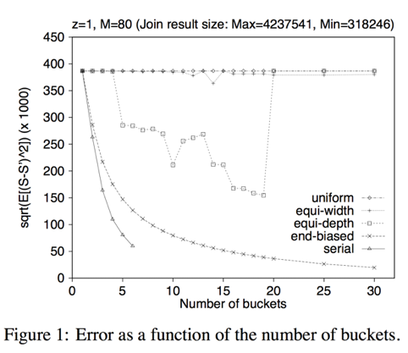
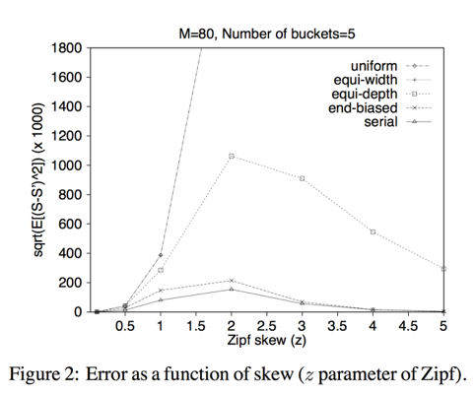
Histogram Comparison

Slide 18
Summary
Serial histograms are optimal
End-biased histograms are suboptimal but far more practical

Slide 19
THX

